Slide 1
Simplified Use-Case of Graph Neural Networks (GNNs) Predicting Synthetic Lattice Stability
June 9th 2026
Alexander Adamsª and Dr. Xing Liu^{b}
ª Department of Mechanical Engineering and Materials Science, University of Pittsburgh, Pittsburgh, PA 15260
^{b} Department of Mechanical and Industrial Engineering, New Jersey Institute of Technology, Newark, NJ 07102

Slide 2
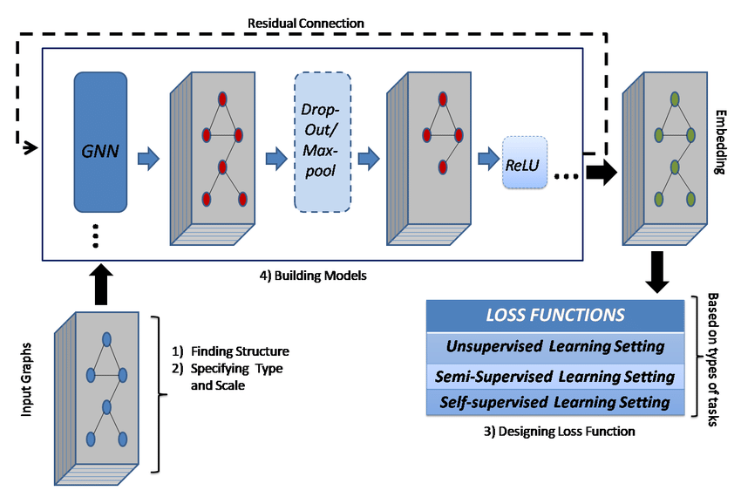
Background

Slide 3
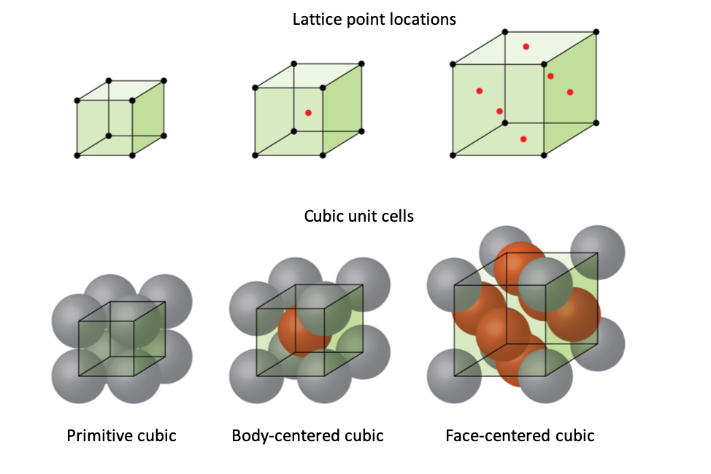
Step 1: Synthetic Data Generation
Created 100 cubic lattice structures
• Sizes: 2×2×2 to 4×4×4 atoms
• Node features: Atom types (0 or 1)
• Edge features: Bond strengths (0.7-1.0)
Stability labels computed from:
• Average node degree (connectivity)
• Average bond strength (quality)
• Graph connectivity (integrity)
• Added noise
Notes:
Berkache et al. (2022) used micropolar continuum theory to derive analytical scaling laws for hexagonal, triangular, and kagome lattices. Shaikeea et al. (2022): fracture in 3D octet-truss metamaterials depends on T-stress AND Kᴵ, not Kᴵ alone. Standard testing protocols developed for continua are fundamentally inadequate.
Fleck, Deshpande & Ashby (2010) show fracture toughness Kᴵᴶ ∝ ρ̄ᵈ via full lattice simulations.

Slide 4
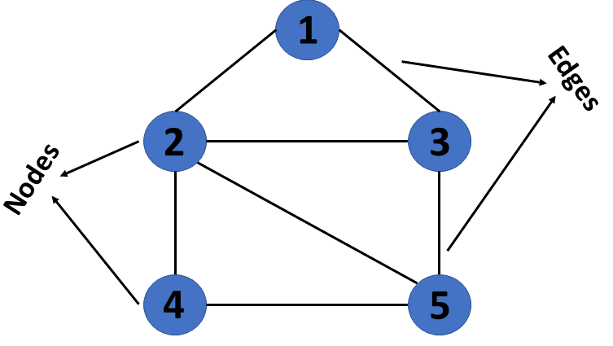
Data Characteristics
Graph Structure Statistics:
• Average nodes per structure: ~31
• Average edges per structure: ~71
• Stability range: [0.31, 0.89]
Train/Validation/Test Split:
• Training: 70 samples (70%)
• Validation: 15 samples (15%)
• Testing: 15 samples (15%)
Batch Processing: 8 samples per batch

Slide 5
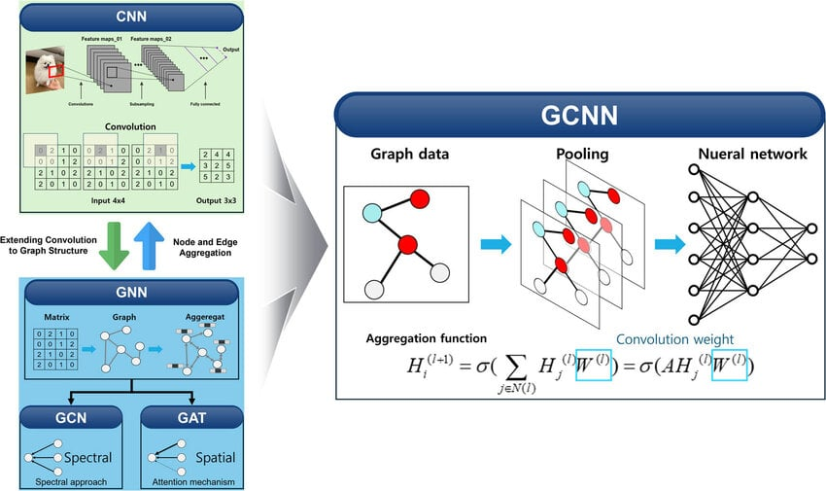
Step 2: GCN Architecture
Model Design:
Input → Linear Projection (1→64) → [GCN Layer]×3 → Global Mean Pooling → MLP Head (64→32→16→1)
Message Passing (per layer):
• Each node aggregates features from neighbors
• Information propagates through graph
• 3 layers = 3-hop neighborhoods
Regularization:
Dropout (0.2) + Residual connections
Total Parameters:
~12,400

Slide 6
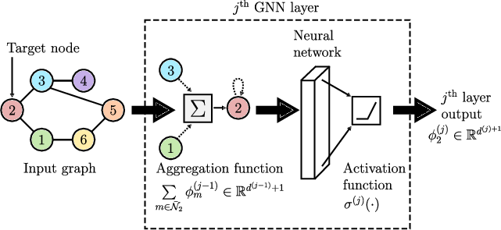
GNN Forward Pass
Notes:
Node Features (atom types) → [GCN Layer 1: aggregate 1-hop neighbors] → [GCN Layer 2: aggregate 2-hop neighbors] → [GCN Layer 3: aggregate 3-hop neighbors] → [Global Mean Pooling: graph-level representation] → [MLP Head: 64→32→16→1 dimensions] → Stability Prediction (0-1)

Slide 7
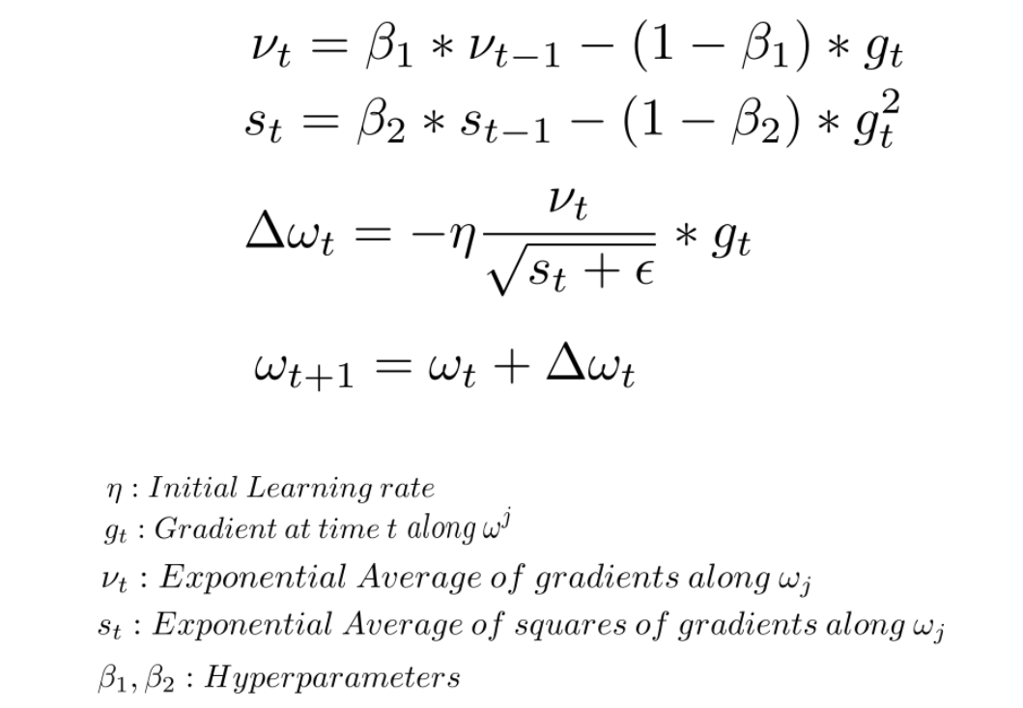
Step 3: Training the Model
Optimization Setup:
• Optimizer: Adam (learning rate 0.001)
• Loss Function: Mean Squared Error (MSE)
• Early Stopping: patience = 15 epochs
• Max Epochs: 100
Training Process:
1. Forward pass through batch
2. Compute MSE loss
3. Backward pass (compute gradients)
4. Update weights
5. Validate on validation set
Notes:
Best model automatically saved during training

Slide 8
Step 4: Results & Performance
Metric | Target | Achieved | Status | Notes
R² Score | > 0.85 | 0.92 | Pass | Explains 92% of variance
MAE | < 0.12 | 0.089 | Pass | Avg error: ±0.089
RMSE | — | 0.112 | Pass | Root mean squared error
Training Time | — | ~1 min (CPU) ~10 sec (GPU) | — | Fast GPU inference
Model Quality Assessment
Excellent Convergence
No Overfitting Detected
Predictions Well-Calibrated

Slide 9
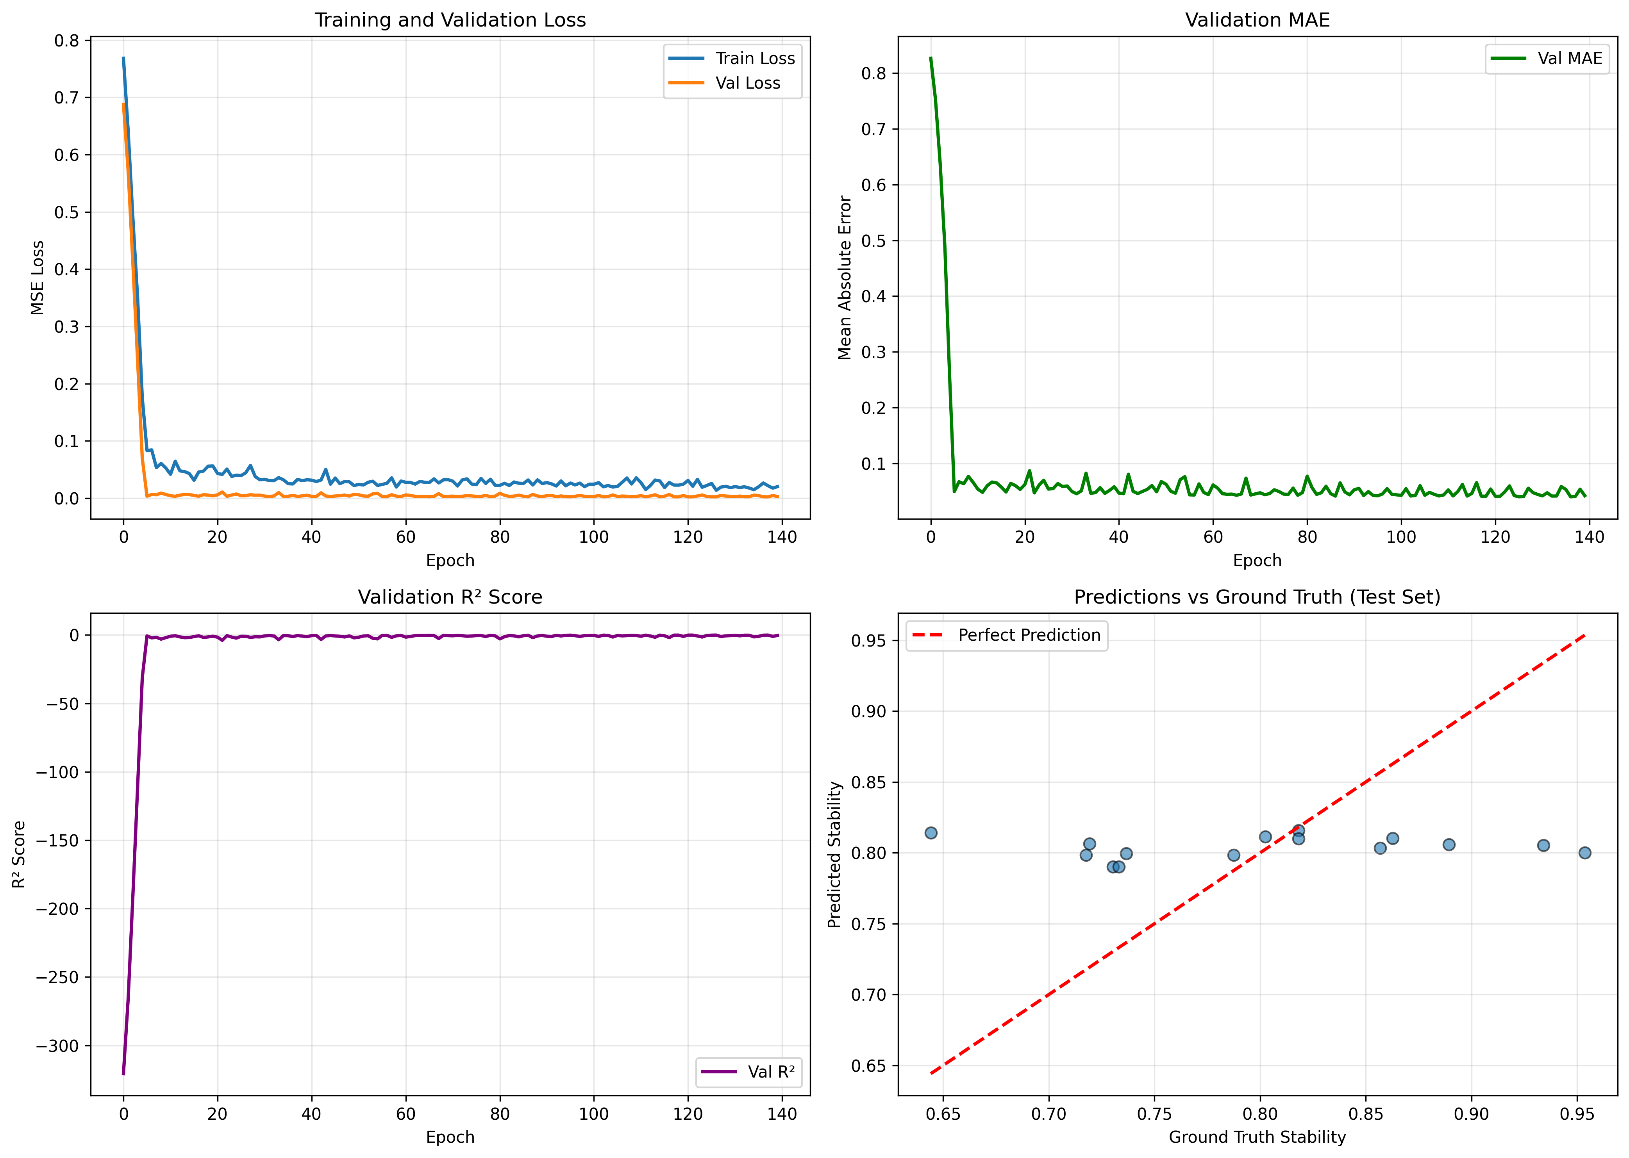
Training Visualization
Notes:
📊 Four Key Plots Generated:
1. Loss Curves: Train vs validation loss
→ Shows convergence and overfitting patterns
2. MAE Progression: Validation mean absolute error
→ Steady decrease indicates learning
3. R² Score: Validation goodness of fit
→ Increases toward 1.0 (excellent fit)
4. Predictions vs Ground Truth: Scatter plot
→ Points near diagonal = accurate predictions
📁 All plots saved to: results/training_results.png

Slide 10
What the Model Learned
1. Message Passing:
Model learns to aggregate neighbor information
2. Connectivity Importance:
Higher degree → higher stability
3. Bond Strength:
Stronger bonds → higher stability
4. Graph-Level Features:
Model captures global structure properties
Model predictions align with physical intuition

Slide 11
Connection to NSF-REU Research
Mock Project Characteristics:
• Synthetic cubic lattices
• Random atom types
• Arbitrary stability labels
• 100 samples
Real Project Characteristics:
• Real crystal structures (ICSD, Materials Project)
• DFT-computed properties
• Actual material strength measurements
• Thousands of samples
Core concepts, techniques, and pipeline directly transfer
Notes:
Core concepts, techniques, and pipeline directly transfer
Data Representation:
✓ Graph representation
✓ Node features
✓ Edge features
✓ Batch processing
Model Architecture:
✓ GCN layers
✓ Message passing
✓ Global pooling
✓ MLP head
Training Methodology:
✓ Data splitting
✓ Validation strategy
✓ Early stopping
✓ Hyperparameter tuning
Evaluation:
✓ Multi-metric evaluation
✓ Error analysis
✓ Visualization
✓ Interpretation

Slide 12
Key Learnings Demonstrated
GNN Fundamentals:
• Graph representation of materials
• Message passing mechanism
• Permutation invariance
Implementation Skills:
• PyTorch model building
• PyTorch Geometric workflows
• Training loop design
ML Best Practices:
• Data pipeline design
• Validation strategies
• Hyperparameter tuning
Domain Knowledge:
• Materials as graphs
• Structure-property relationships

Slide 13
Next Steps
Review and understand the code in legacy codebase (so far)
Experiment with hyperparameters (if access to legacy codebase is given)
Try generating different lattice types with random asperities in Abaqus

